Slide 1
YouTube Viral
Prediction Web App
By: John Solo

Slide 2
Overview
Created a web service that allows users to predict whether their video idea will be viral in the future
User types their idea
Service runs idea through model
User sees prediction

Slide 3
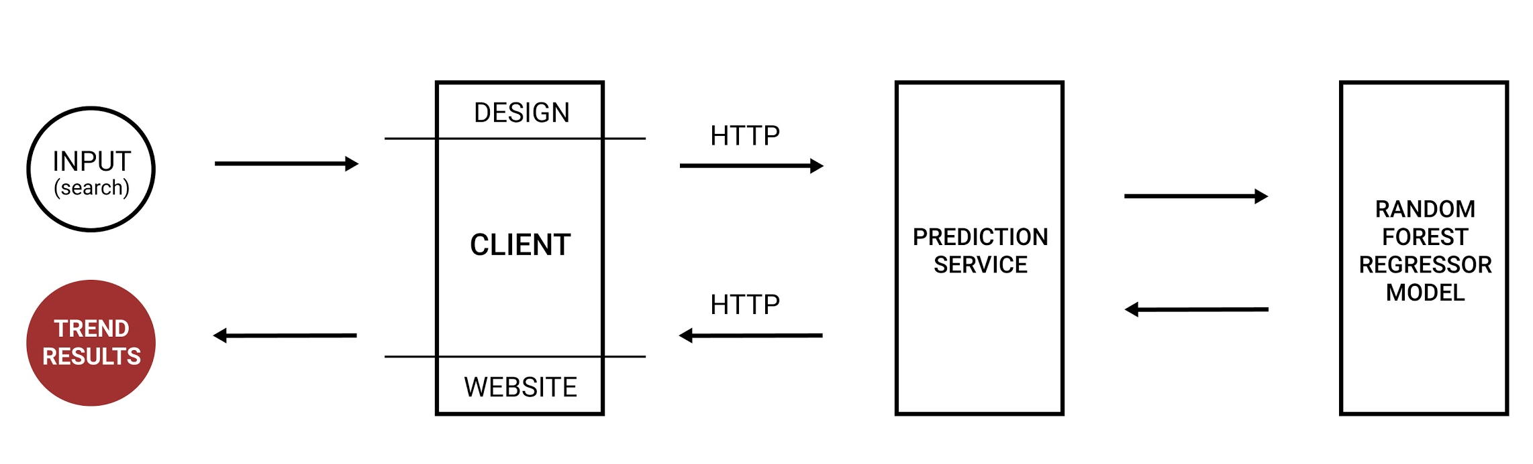

Slide 4
Individual Contribution
Created a REST API to receive data from client
Send JSON response to the client
Designed a simple mock UI interface to test HTTP calls

Slide 5
Demo
http://localhost:5000/

Slide 6
Next Steps
Predict how long a video will take to trend
Sort through different categories
Expand to more than just English

